Slide 1
Findings and Next Steps
Donna S. Dempsey
November 12, 2013

Slide 2
Amcor
Anheuser-Busch LLC
Ball Corporation
Bemis
Colgate-Palmolive Company *
ConAgra Foods *
DuPont Packaging & Industrial Polymers *
Earth911
Exopack
ExxonMobil Chemical
General Mills Inc.
H. J. Heinz Company
Kellogg Company *
Kraft Foods Group Inc.
McDonald’s
Member Companies
MWV *
NatureWorks LLC
Owens Illinois, Inc.
PaperWorks Industries
PepsiCo
Procter & Gamble *
Rehrig Pacific Company
Saint-Gobain Containers, Inc.
Sealed Air Corporation *
Sonoco
Tetra Pak, Inc. *
The Coca-Cola Company *
The Dow Chemical Company *
The Hershey Company
Waste Management, Inc.
Founding Member *

Slide 3
2013-2014 Technical Advisory Committee
Ashley Carlson | American Chemistry Council
Cathy Foley | American Forest & Paper Association
Megan Daum | Can Manufacturers Institute
Lynn Dyer | Foodservice Packaging Institute, Inc.
Jane Bickerstaffe | Incpen
Joe Hotchkiss | MSU School of Packaging
Tom Egan | Packaging Machinery Manufacturers Institute
Garth Hickle | State of Minnesota
Erin Simon | World Wildlife Fund
Meghan Stasz | Grocery Manufactures Association
Sego Jackson | Snohomish County, WA – local
Jay Bassett | EPA Region 4
Sara Hartwell | US EPA
Brenda Pulley | Keep America Beautiful
Nina Goodrich | SPC
Alan Blake | PAC Next

Slide 4
Vision
The goal of AMERIPEN is to be the recognized cross-sectional North American industry and trade organization that advocates and educates on environmental packaging issues related to legislation and regulation.
Notes:
Guide local and state legislators to polies that are environmentally sound, cost effective and REGIONALLY APPROPRIATE.
Taking our data to targeted states and municipalities
Continue with the next few pieces in our Value of Packaging Series

Slide 5

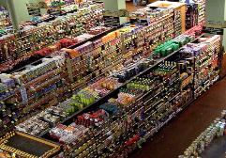
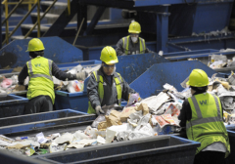
AMERIPEN will achieve its vision by:
  Providing DATA
  Taking ACTION that
      Reinforces the Value of Packaging
      Increases Recovery of Packaging
  LEADING collaboration

Slide 6

Collaboration
Members
Technical Advisory Group
External Stakeholders

Slide 7
100 Cities Survey
AMERIPEN sponsored research to identify proven best practices.
These five areas were found to be key to effective recovery of packaging.
Identify gaps and opportunities.
Processing
Collection
Education
Local/State Policy
Financial
Notes:
AMERIPEN sponsored research to identify proven “best practices” for effective recovery in cities across the US. These best practices have a focus on the success of curbside recycling – but have application across the spectrum of recovery from institutional and commercial recovery as well as residential single and multi-family. Given our available budget we chose curbside as a starting point given its direct practical application for cities, towns and villages across the country. Our Recovery Work Group vetted these practices, working with our TAG that included representation from both industry and government.
These five areas of best practice were found to be the key to effective recovery of packaging
Processing – providing effective systems to sort recyclables and prepare them for markets
Collection – efficiently and conveniently moving material from home to recycling facilities
Financial – incorporating good business practices for financial management of recovery programs
Local/State Policy – adopting policies at the state and local level – including incentives – that support recovery
Education – communication so that residents are motivated to recycle and know what, when where and how to recycle
The Recovery Work Group then surveyed the 100 largest cities to track their adoption of these best practices and correlate best practice adoption to current recovery compared to potential recovery.

Slide 8
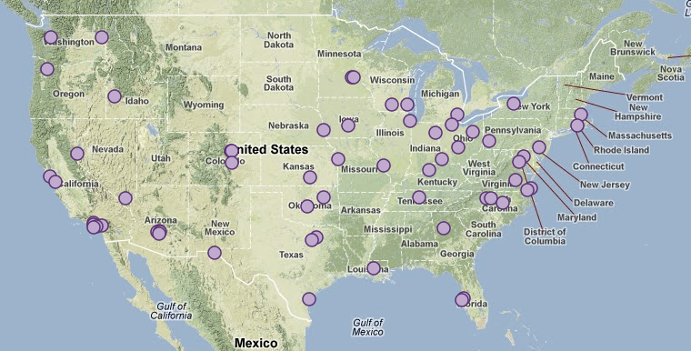
100 Largest Cities Survey
Nearly 80% response rate
Notes:
As you can see from this map, the response from the 100 Largest Cities Survey was very solid. 80% of the cities responded and those communities were very interested in offering both support and data. The map shows the spread of the 100 largest cities across the country – building a solid platform of data on recovery best practice adoption for a large portion of the nation’s population.

Slide 9
Direct Correlation between Adoption and Recovery
Supply
Expansion Potential
Capacity
Processing
Collection
Education
Local Participation Strategies
Government Engagement
NO ONE SILVER BULLET!
Notes:
The results of the 100 largest cities survey found that there is a direct correlation between best practice adoption and levels of recovery. The key to creating high recovery performance is adoption of best practices in each of the five key areas. Programs that were short in even one or two of the five areas showed diminished results. There is “no one silver bullet” – excellence requires effort in all five areas. Even more interesting is that there are a menu of choices within this suite of best practices – with the ability for cities to tailor fit the right mix of solutions for their unique needs – as long as the parts work together in each of the five best practice areas.
The 100 largest cities survey results also show that adoption across the US of this comprehensive approach to best practices for recovery creates the potential to efficiently recover significantly more material than we do today. The data shows that there are clear areas for improvement with standardization and implementation of best practices to move the needle on increasing the recovery of used packaging.
The data shows that successful recovery and economic viability is rooted in the adoption of these best practices and policies – a pathway for expansion to generate the necessary capacity to increase the supply of recyclables that industry needs.

Slide 10
Recovery Infrastructure
Education
Local and State Participation
Opportunity to move the needle with 3 Key Initiatives
Processing
CARTS AND EDUCATION
Expanded access with rolling carts
Maximize types of packaging materials collected
Leverage hub and spoke models to drive supply
Optimize MRF utilization and operational efficiency
Education
INCENTIVES AND EDUCATION
Sustained incentive-type programs
Targeted community based social marketing/incentives
State Partnerships, CVP, KAB and Earth911
Funding levels at or above $1 per household
Local Participation
POLICIES AND AND EDUCATION
Unit based pricing programs
Local recycling ordinances
State level landfill bans/mandated recycling
Government
Engagement
Notes:
The 100 Largest Cities Survey then moved to a next step - analysis of specific initiatives that could move the needle of recovery in targeted cities.
Three initiatives were identified – with education being a common theme in each initiatives, matched with:
- Rolling large capacity recycling carts and efficient collection and processing – to make recycling easy and convenient
- Incentives to engage each resident and the entire community in the commitment to recycling
- Policies that provide the right mix of supporting rules and price messaging to support recycling
A subgroup of the 100 cities was selected for a more detailed analysis of which of these three initiatives would match their needs best – and what the possible impact on recovery would be. Working with published data and preliminary information from each of these communities enabled the team to identify the ten year impact in terms of both recovery and cost.
These results were then aggregated to a wider dataset of communities across the country to illustrate nation wide impact of best practice adoption.

Slide 11
Carts & Education Initiative
Notes:
The assessment of best practices for carts and education showed that widespread adoption across the country would expand recovery of used packaging. Even though our findings for the 100 largest cities showed that 80% were already using carts for recycling we found that a much lower percentage were matching that best practice approach to carts with best practice effort in funding for education and awareness. Those communities that matched both carts and education demonstrated higher levels of recovery performance.

Slide 12
Incentives & Education Initiative
Notes:
Similarly, Incentives can have a roll to play in materials getting collected and recycled. 20 out of the 73 who answered that question or 27% have some type of incentive structure – analysis indicates that initiatives to strengthen the incentives for recycling can result in a 15% increase in participation and a 20% increase in materials collected.

Slide 13
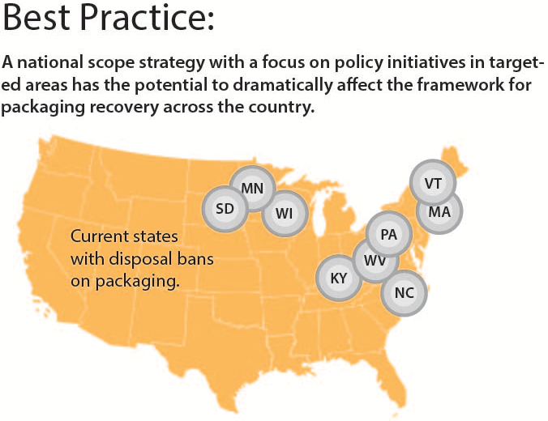
Policy & Education Initiative
Policy Initiatives include local recycling ordinances, state disposal bans, PAYT programs, but about 20% of these communities use these strategies.
Notes:
Finally, the analysis found that policy initiatives have a roll to play in driving a wide range of packaging recovery. These include adoption of local recycling ordinances, state disposal bans on certain types of easily recycled packaging, pay as you throw and unit based pricing as well as other similar local and state participation strategies. Despite the fact that these measures represent low cost approaches to boosting recovery - Only about 20% of these communities some of use these strategies. Those that did were able to demonstrate higher recovery performance.

Slide 14
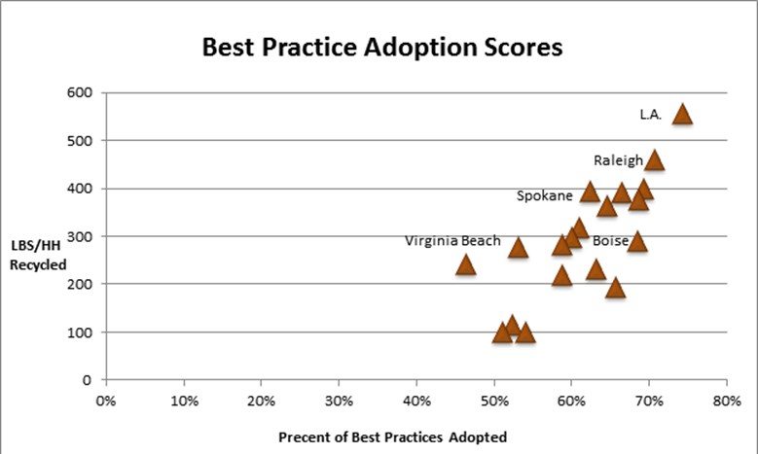
Improves efficiency, increases revenue, decreases waste disposal costs
Processing
Education
Local and State Policy
Financial
Notes:
The Proof Point – as shown in this graph of best practice adoption by a sample of the surveyed communities – correlated to recovery levels (measured in lbs per household) – illustrating that the critical mass of best practice adoption is around 70% before their combined impact shows up in high performance at the curb – and more recyclables delivered to market with all the economic benefits that comes with that high recovery.
By applying these proven approaches, communities can transform average programs into best in class performers – going from good to great – which improves efficiency, increases revenue from commodities, decreases waste disposal costs and more fully utilizes the existing system for curbside recycling.

Slide 15
Analysis of Strategies & Financial Platforms to Increase Recovery of Used Packaging
Notes:
This is the first time that recovery programs in the US, Canada, Europe and Australia have been examined in detail and compared in terms of both their environmental and economic effectiveness. It’s a white paper that studied global systems that support improved packaging recovery and system financing.
We were looking to identify strategies and financial mechanisms used across the globe that are the most effective and efficient in recovery and recycling of used packaging, while addressing financing challenges of collection, sorting and transportation.

Slide 16
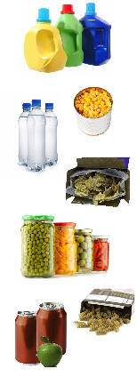
Project Objective
Determine the most effective
and efficient ways to improve
recovery of used packaging in
the United States, while addressing financing challenges of collection, sorting and transportation.

Slide 17
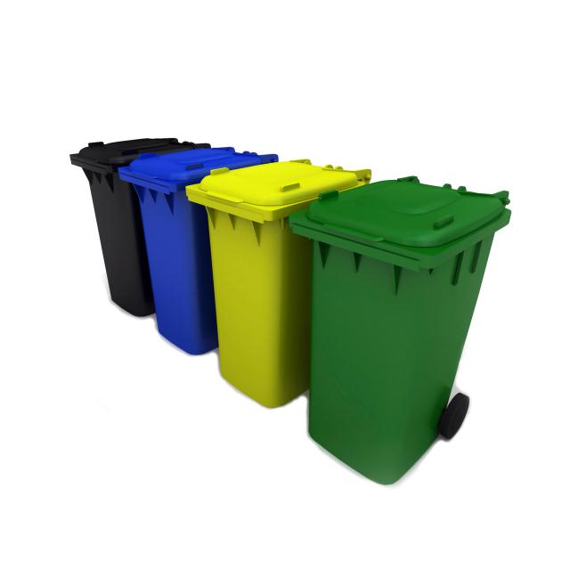
Project Strategies
Explore the variety of waste management programs implemented across the globe, identifying best practices and challenges.

Slide 18
Project Strategies
Explore the variety of waste management programs implemented across the globe, identifying best practices and challenges.
Understand and identify inter-linkages between policy and tools within a waste management system.

Slide 19
Project Strategies
Explore the variety of waste management programs implemented across the globe, identifying best practices and challenges.
Understand and identify inter-linkages between policy and tools within a waste management system.
Ensure we produced a data-based and non-biased report, staying true to the mission of AMERIPEN.

Slide 20
Opportunities
51% of domestic packaging is recycled, vs. 63% in Europe.
Nearly 23% of disposed municipal solid waste in the U.S. is packaging.
Thus, there are significant opportunities for recovery improvement.
Recycling Rates in the U.S. and E.U.
MSW | EU (2011) | US (2011)
Recycling | 39% | 35%
Packaging | EU (2010) | US (2011)
Recycling | 63% | 51%
Material Specific | EU (2010) | US (2011)
Glass | 69% | 51%
Plastics | 33% | 13%
Paper | 83% | 75%
Metal | 72% | 57%

Slide 21
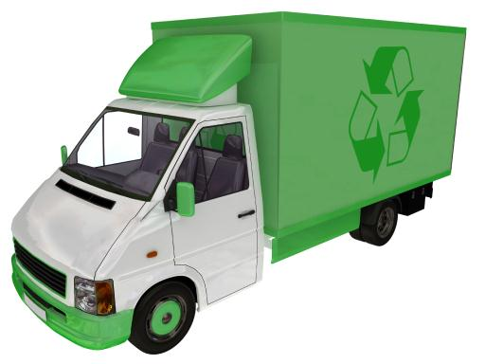
Challenges to Increased Recovery
Recovery and waste management programs operate within a broad array of geographic, political, economic, and cultural influences, that are under utilized and highly fragmented.

Slide 22
Challenges to Increased Recovery
Recovery and waste management programs operate within a broad array of geographic, political, economic, and cultural influences.
Additionally, most governments employ multiple approaches to waste management. Studies of singular programs fail to consider this complexity.

Slide 23
Challenges to Increased Recovery
Recovery and waste management programs operate within a broad array of geographic, political, economic, and cultural influences.
Additionally, most governments employ multiple approaches to waste management. Studies of singular programs fail to consider this complexity.
These differences make it difficult to compare and project program costs, efficiencies, and results.
Notes:
You can’t compare programs. It is an apples to pears comparison, as stated by Alan Blake with Pac Next.

Slide 24
Common Waste Reduction Strategies
The following strategies appeared most frequently within our analysis of packaging waste:
  Disposal Bans
  Mandatory Recycling
  Unit Based Pricing / Pay-As-You-Throw
  Advance Disposal / Recycling Fees
  Container Deposits / Bottle Bills
  Landfill Taxes / Surcharges
  Extended Producer Responsibility
Notes:
Criteria against every one of these strategies consist of strengths, challenges, financial stability, behavioral change potential, and packaging recovery potential from both an implementation and overall effectiveness perspective.

Slide 25
Overarching Report Findings / Recommendations
No single program was found to achieve all goals:
  Sustainable financing
  Increased recovery, especially for hard to recycle packaging
  Stakeholder awareness and participation

Slide 26
Overarching Report Findings / Recommendations
No single program was found to achieve all goals:
  Sustainable financing
  Increased recovery, especially for hard to recycle packaging
  Stakeholder awareness and participation
Proper planning, education, outreach and incentives for participation are key elements of any successful program.

Slide 27
Overarching Report Findings / Recommendations
No single program was found to achieve all goals:
  Sustainable financing
  Increased recovery, especially for hard to recycle packaging
  Stakeholder awareness and participation
Proper planning, education, outreach and incentives for participation are key elements of any successful program.
States and municipalities should not consider recovery strategies in isolation either within or across jurisdictions.

Slide 28
Overarching Report Findings / Recommendations
No single program was found to achieve all goals:
  Sustainable financing
  Increased recovery, especially for hard to recycle packaging
  Stakeholder awareness and participation
Proper planning, education, outreach and incentives for participation are key elements of any successful program.
States and municipalities should not consider recovery strategies in isolation either within or across jurisdictions.
Adoption of harmonized definitions and
reporting mechanisms is needed for program
planning, execution, and assessment.

Slide 29

Recommended Approach
AMERIPEN’s research suggests a combination of approaches – or “Toolbox”– may result in the greatest success.
Performance
WTE
Legislation
Geography/Density
Culture
Increased &
financially stable recovery
Landfill Bans
Recycling
EPR
Education/
Awareness
Recycling Mandates
AD/RF
Landfill Taxes
Consumer Incentives
Bottle
Bills
Pay-As-You-Throw

Slide 30
Recommended Approach
AMERIPEN’s research found that the 3 most effective and efficient programs
for addressing sustainable system financing and increased recovery include:
  Mandatory Recycling and Disposal Bans
    Implemented together, these two strategies have demonstrated success towards increasing material recovery.
    Increased income from related fees and material recovery streams can provide financing to support infrastructure needs. However, enforcement mechanisms and infrastructure support are required for success.
  Pay-As-You-Throw
    These programs are self-sustaining, and costs of program implementation are born by rate payers, driving the greatest influence on behavior change.

Slide 31

Next Steps
AMERIPEN will:
Use these findings to continue the
dialogue with cities and states.
Determine its role in helping to expand
the adoption of these best practices.

Slide 32
Thank You

